Slide 1
Learn Programming for Beginners
Centre for Health Informatics
Alexander Krusina
Adam D’Souza, Sylvia Hao, Elliot Martin
Jan 29th, 2020 - Variables/Types, If/Else, Loops

Slide 2
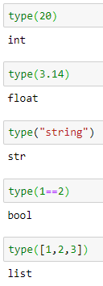
Variables
Storing information
Different types
Integer - 6
Float - 3.14
String - “Hello world”
Boolean - True/False
List - [1, 2, 3, 4.5, “Hi”, False]
Dynamic typing

Slide 3
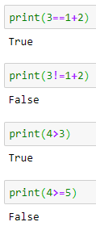
Variables - Assignment, Operations and Equality
Assignment
=
Operations - numbers
Equality
==
>
>=
<
<=
!=
+ | Addition
- | Subtraction
* | multiplication
/ | division
// | whole number division
** | exponent
% | modulus (remainder)

Slide 4
Variables - Casting
Converting variable types to other types
Reading numerical input
Evaluating equality

Slide 5
Variables - Strings
Concatenation - adding strings together
Length - len(my_string)
Indices
Accessing specific character(s)
Counting starts at 0
my_string[0]
my_string[0:2]

Slide 6
Variables - Lists
Length and indices - similar to strings
Removing from a list
remove - removes the first instance of an element
pop - removes the last element
Adding to a list
insert - inserts an element at a specified location
append - adds an element to the end
Combining lists
extend

Slide 7
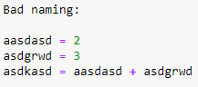
Variables - Naming Convention
Names should describe the purpose of the variable
Can’t use keywords - list of keywords
Python style conventions
underscores or camel case
my_variable
myVariable
Can’t start with a number

Slide 8
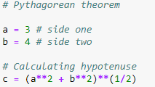
Comments
Adding comments to code helps improve readability
Lets others understand your code

Slide 9
If/Else Statements
Used to conditionally run lines of code
Requires a condition (boolean)
Colon following the condition
Can have ‘else if’ conditions also

Slide 10
If/Else Statements
1 ‘if’ statement (mandatory)
unlimited ‘else if’ (elif) (optional)
1 ‘else’ (optional)
indent indicated scope
‘and’ keyword requires multiple conditions to be met
‘or’ keyword allows for 1 of multiple to be met

Slide 11
Loops
For loops
Define list
Do something for every value in the list
While loops
Has a condition
Will run as long as the condition is true
Can easily become an infinite loop if you aren’t careful

Slide 12
Loops
Break
Breaks out of the loop
Usually used inside of an if statement
Continue
skips the rest of the code in the current run through the loop
Range function

Slide 13
Wrapping Up
Questions/Feedback?
Email list
Github - slides, examples, practice problems and solutions
Next Week:
Functions
Data Structures

